Slide 1

The Influence of Dose Rate on Lung Cancer Induction From Inhalation of Beta-Gamma Emitting Radionuclides
Stephanie Puukila
Flinders University/Laurentian University
American Nuclear Society & Health Physics Society
Applicability of Radiation-Response Models to Low Dose Protection Standards
October 2, 2018

Slide 2
Declare no conflict of interest
Funding provided by a research grant from Bruce Power

Slide 3
Introduction
Inhalation Toxicology Research Institute (Lovelace Respiratory Research Institute) life-span Beagle dog experiments from 1967-1991.
Concern over the possibility of catastrophic accident(s) in large nuclear power plants and inhalation of fission-product radionuclides.
Long-life span, similar sensitivity to radiation induced cancer, develops a similar spectrum of cancer types, each individual can be treated as a clinical subject.

Slide 4
Exposure
Inhaled insoluble fused aluminosilicate particles containing radionuclide.
Radionuclides
⁹⁰Sr
¹⁴⁴Ce
⁹¹Y
⁹⁰Y
Prolonged retention in the lung - majority of dose delivered to lung.
Notes:
Beta emitting

Slide 5
Dose Rate
May be important to separate dose effects and dose rate effects when considering radiation induced risk.
Dose rate at the time of one effective half-life in the lung for each radionuclide (DR_{ef}). Reflection of the rapidly changing dose rate, energy and biological response.
Dose rate per cell turnover (DR_{CT}) as a metric of damage based on the average doubling time of a lung epithelial cells (~30 days).

Slide 6
Limitations
Relatively small number of dogs in the study
52 controls
100 exposed to ⁹⁰Sr
104 exposed to ¹⁴⁴Ce
95 exposed to ⁹¹Y
83 exposed to ⁹⁰Y
Just focused on the lung
Notes:
Ce – LC – 27 = 26% all 42%
PI - 17 = 16%
Sr – LC – 30 = 30% all 64%
PI – 34 = 34%
90Y – LC – 10 = 12% all 57%
PI – 37 = 45%
91Y – LC – 33 = 35% all 78%
PI – 41 = 43%

Slide 7
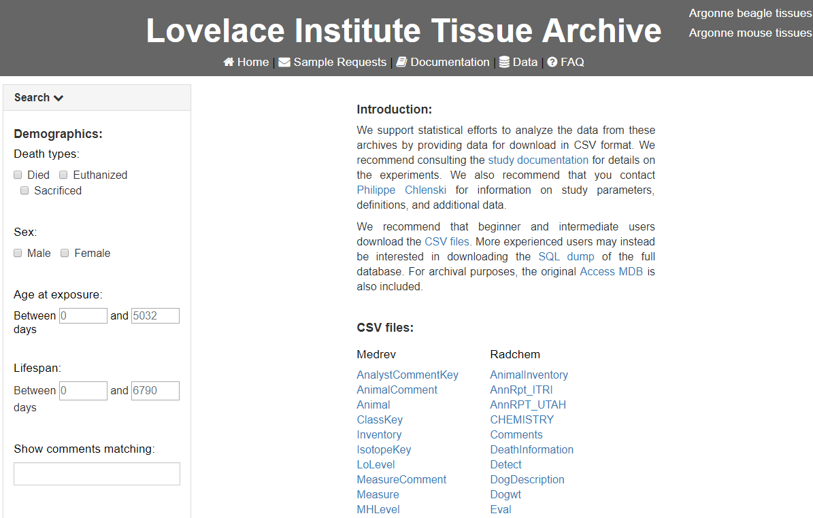
http://janus.northwestern.edu/lovelace/data.php

Slide 9
Radionuclide | Physical half-life | Effective half-life in lung (d) | Average time to deliver 50% dose | Average number of cell turnovers* | Average dose/cell turnover (Gy)*
⁹⁰Sr | 29 y | 600 | 1.1 y | 49 | 26.65
¹⁴⁴Ce | 285 d | 175 | 145 d | 22 | 21.53
⁹¹Y | 59 d | 50 | 50 d | 7 | 31.70
⁹⁰Y | 2.6 d | 2.5 | 2.5 d | 1 | 116.18
*Assuming a cell turnover time of 30 days

Slide 10
⁹⁰Sr
¹⁴⁴Ce
⁹¹Y
⁹⁰Y
Puukila et al. 2018. The Influence of Changing Dose Rate Patterns from Inhaled Beta-Gamma Emitting Radionuclide on Lung Cancer. International Journal of Radiation Biology. doi:10.1080/09553002.2018.1511929

Slide 11
⁹⁰Sr
¹⁴⁴Ce
⁹¹Y
⁹⁰Y
Puukila et al. 2017. The role of radiation induced injury on lung cancer. Cancers. 9(7):89.

Slide 12
 | Control | ⁹⁰Sr | ¹⁴⁴Ce | ⁹¹Y | ⁹⁰Y
DR_{LA} (Gy/Day) | 0 | -0.61 | -0.66 | -0.64 | -0.75
DR_{ef} (Gy/Day) | 0 | -0.80 | -1.18 | -1.37 | -1.94
DR_{CT} (Gy/CT) | 0 | -0.54 | -1.14 | -1.38 | -1.04
Puukila et al. 2017. The role of radiation induced injury on lung cancer. Cancers. 9(7):89.
Puukila et al. 2018. The Influence of Changing Dose Rate Patterns from Inhaled Beta-Gamma Emitting Radionuclide on Lung Cancer. International Journal of Radiation Biology. doi: 10.1080/09553002.2018.1511929

Slide 13
Conclusions
Sharp break points in the responses to internally deposited radioactive materials.
DR_{ef} provided a better reflection of radiation risk.
Additional information on
mechanisms involved in low dose, dose rate and rapidly changing dose rate responses.
cell killing, tissue disorganization, and chronic inflammatory disease and cancer induction.

Slide 14
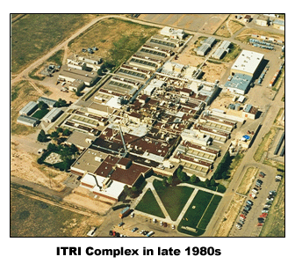


Acknowledgements
Dr Tatjana Paunesku
Dr Benjamin Haley
Dr Dani-Louise Dixon
ITRI team

